Slide 1
MANTINA PRASAD
FINAL PROJCET

Slide 2
keylogger
KEY LOGGER AND SECURITY

Slide 3
INTRODUCTION TO KEYLOGGERS
A keylogger or keystroke logger/keyboard capturing is a form of malware or hardware that keeps track of and records our keystrokes as we type. It takes the information and sends it to a hacker using a command-and-control (C&C) server. The hacker then analyzes the keystrokes to locate usernames and passwords and uses them to hack into otherwise secure systems.
Types of Keyloggers
SOFTWARE KEYLOGGER
HARDWARE KEYLOGGER

Slide 4
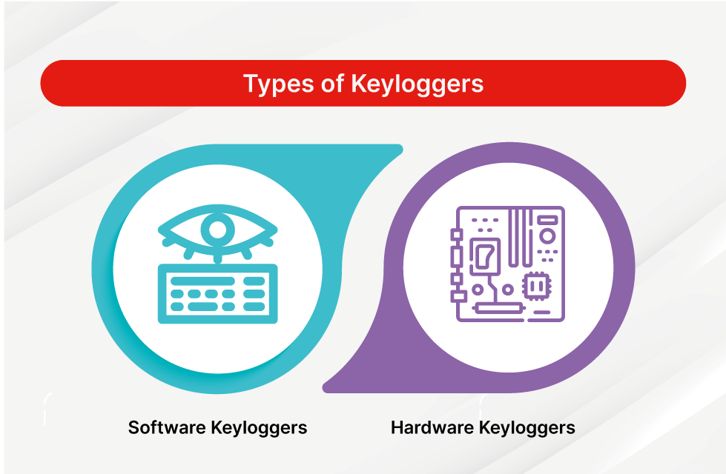

Slide 5
SOFTWARE KEYLOGGER
Software keyloggers consist of applications that have to be installed on a computer to steal keystroke data. They are the most common method hackers use to access a user’s keystrokes.
A software keylogger is put on a computer when the user downloads an infected application. Once installed, the keylogger monitors the keystrokes on the operating system you are using, checking the paths each keystroke goes through. In this way, a software keylogger can keep track of your keystrokes and record each one.

Slide 6
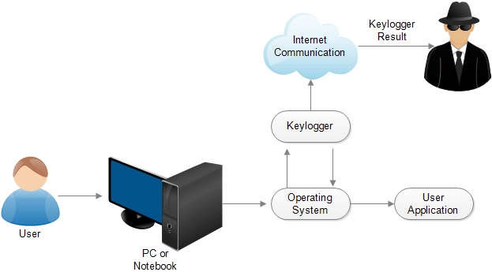

Slide 7
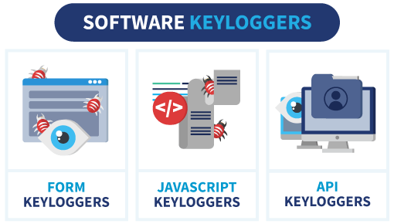

Slide 8
1.Javascipt based key logger
*It is a malicious script key-logger which is installed into a web page ,And listens for key to press such as onekeyup().these script can beVarious methods like sharing through social meadia ,sending as amail.
2.From based key loggers
*These are key-logger which activates when a person file from a from
Online and click the button submit all the data or the words written is sent via file on computer .some key-logger works as a API in running application
It looks like a simple applocatiom and wherever a key is passed it records it.

Slide 9
HARDWARE KEYLOGGERS
A hardware keylogger works much like its software counterpart. The biggest difference is hardware keyloggers have to be physically connected to the target computer to record the user's keystrokes. For this reason, it is important for an organization to carefully monitor who has access to the network and the devices connected to it.
If an unauthorized individual is allowed to use a device on the network, they could install a hardware keylogger that may run undetected until it has already collected sensitive information. After hardware keystroke loggers have finished keylogging, they store the data, which the hacker has to download from the device.

Slide 10
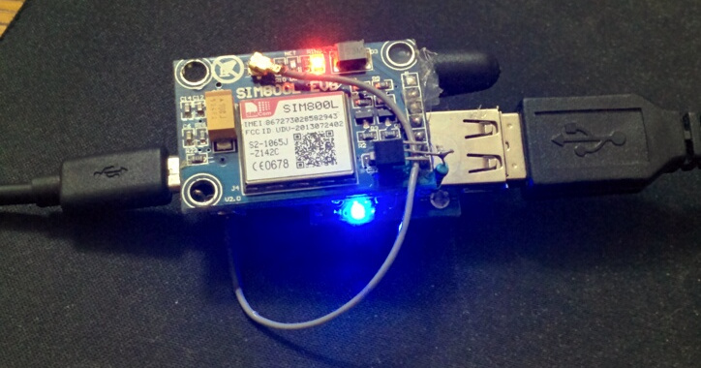

Slide 11
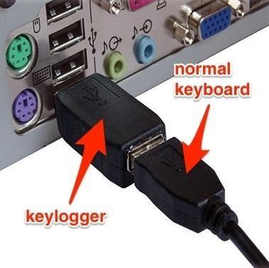

Slide 12
1.USB KEYLOGGER :
These are computer key-logger which has to be to connect to a computer and steals the data.also some circuit are built into a keyboard so no external wire I used or shoes on the keyboard
2.SMART PHONE SENSORS:
Some cool android tricks are also used as key logger such as android accelemeter sensor which when place near to the keyboard can sense thevibration and the graph then used to convert it to sentences ,this technique accurancy is about 80%.Now adays hacrackers areused key-stoke logging trojan,it is a malware which is sent to a victims computer to steal the data and login details.

Slide 13

PROBLEM STATEMENT
In today's digital age, cybersecurity threats pose a significant risk to individuals and organizations alike. One such threat is the proliferation of keyloggers, both in the form of software and hardware, which clandestinely capture keystrokes made by users on computers and mobile devices. These keyloggers, when deployed maliciously, can compromise sensitive information, including passwords, credit card details, and confidential communications.
While keyloggers can have legitimate uses, such as monitoring employee activity or parental control, their potential for misuse underscores the importance of developing robust security measures to protect against unauthorized access and exploitation. Furthermore, the ethical and legal implications of keyloggers necessitate careful consideration to ensure compliance with privacy regulations and respect for individual rights.

Slide 14

PROJECT OVERVIEW
A Key Logger is a tool that captures and records all user inputs with the keyboard.It means that recording every keystroke is made and buttons clicked. This information will be stored in a text file,which is a readable format.It also capable of tracking and recording the user's online activities.
For instance,if a user opens chrome and search for a image(as like "nature images"),
then in the text file it will be stored as['n''a''t''u''r''e'Key.space'i''m''a''g''e''s'Key.enter]
This comprehensive data collection provides a detailed overview of user's activities.
Make sure that use of such tools must comply with legal privacy rules and ethical guidelines.
Unauthorized use of keyloggers can lead to severe legal consequences.

Slide 15
WHO ARE THE END USERS?
Parents: Concerned parents may use keyloggers to monitor their children's online activities and ensure they are safe from online predators or engaging in appropriate behavior.
Employers: Employers may use keyloggers to monitor employees computer activities to ensure they are staying productive, following company policies, or not engaging in any activities that could harm the company's reputation or security.
Legitimate Security Professionals: Many security professionals and IT administrators may use keyloggers as a part of their job to monitor and track activities on company devices to ensure compliance, prevent data breaches, or investigate security incidents.
Cybercriminals: Unfortunately, cybercriminals can also be end users of keyloggers, often for malicious purposes such as stealing sensitive information like login credentials, financial data, or personal information for identity theft or other nefarious activities.

Slide 16

YOUR SOLUTION AND ITS VALUE PROPOSITION
Encryption: Encrypting sensitive data even at rest and in transit can prevent unauthorized access including keyloggers.
Regular software update management: Keeping operating systems, applications and security software up-to-date with latest versions can help protect against known vulnerabilities that keyloggers may exploit.
User Education and Awareness: Educating users about the risks of keyloggers and other security threats, as well as providing training on safe computing practices, can help prevent installation or exposure to keyloggers.

Slide 17
Antivirus and Anti-malware Software: Utilizing reputable antivirus and anti-malware software can help detect and remove keyloggers and other malicious software from devices.

Slide 18

THE WOW IN YOUR SOLUTION
Multi-Layered Defense: The solution doesn't rely on a single security measure but combines multiple layers of defense, including antivirus software, firewalls, encryption, user education, access controls, and behavioral analysis. This multi-layered approach increases the effectiveness of the overall security posture.
Proactive Protection: Rather than merely reacting to security incidents after they occur, the solution emphasizes proactive measures such as regular software updates, patch management, and user
awareness training. By staying ahead of
potential threats, organizations can reduce
the likelihood and impact of security breaches.
18

Slide 19
MODELLING
IMPORT MODULES: Importing modules and libraries such as tkinter,pynput,json.
SETTING UP LOGGING: Configure logging settings to specify the format and destination of log and json files.
DEFINING KEYLOGGER FUNCTIONS: Creating function to capture and log keystrokes.
MAIN FUNCTION: This function is used to start the keylogger and keep it run indefinitely until user stops.
TESTING: Test the keylogger whether it captures keystrokes correctly or not.
DEPLOYMENT: Deploy the keylogger on target systems if necessary under legal and ethical considerations.
19

Slide 20
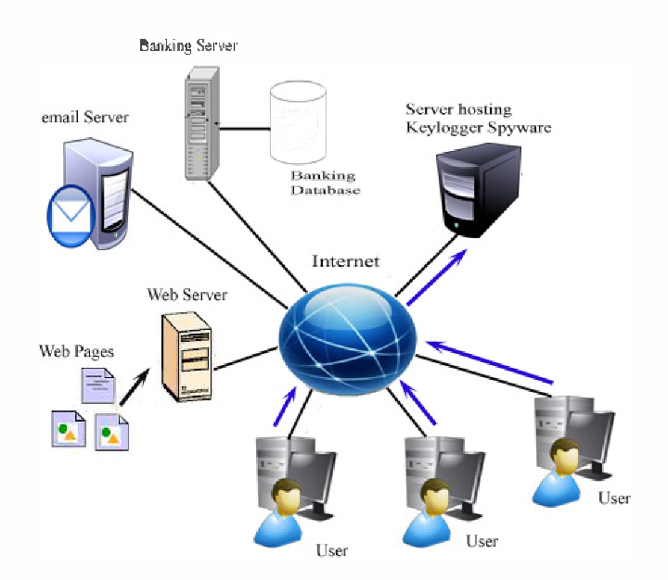

Slide 21
Project link
https://github.com/190532/KEYLOGGER

Slide 22
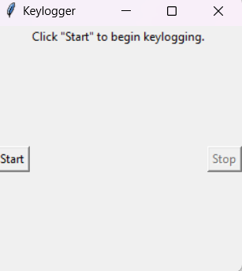
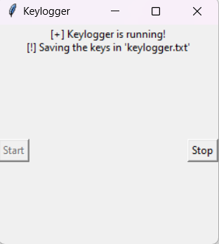
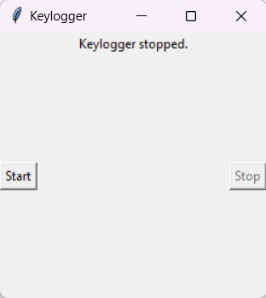
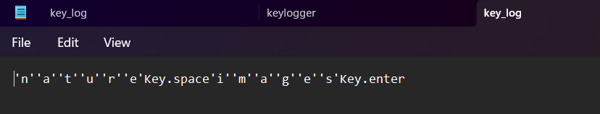
RESULTS
3/21/2024 Annual Review
22

